Slide 1
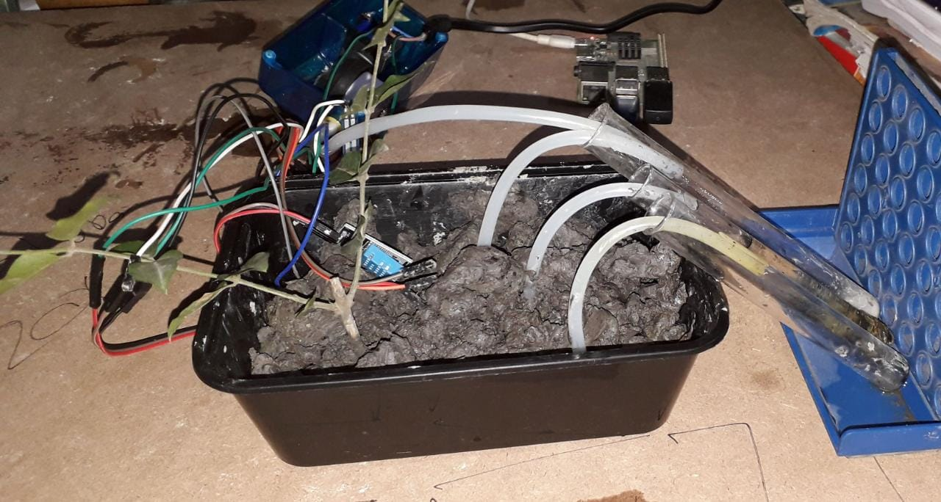
Impact of Proposed Solution:

Slide 2
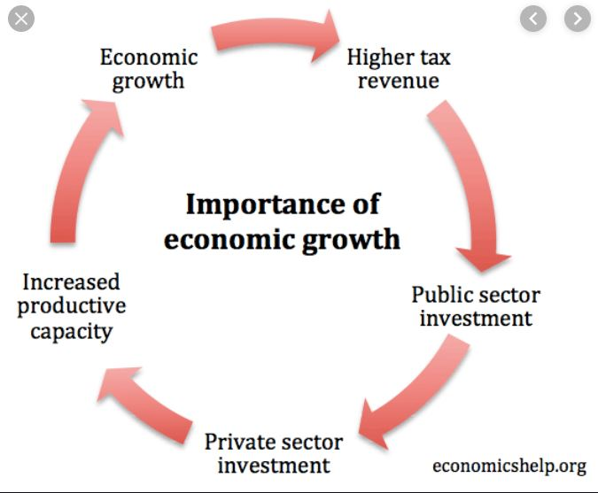
Stability over Uncertainty
Certainty is brought as :
Choice of Crop
Choice of Fertilizer
Monthly Salary
Stable gain

Slide 3

Economic Prosperity
Less wastage of fertilizers
Less usage of energy
Increase in GDP
Foreign exchange
Uniform distribution in money

Slide 4

India is established as a superpower
Strong Agricultural Backbone
Brain drain of other agricultural geniuses(from developed countries,mostly) into India

